Slide 1

Pixel Coliseum
The purpose is to design and develop a web-based 2D co-operative survival arena game that demonstrates real-time multiplayer networking, intelligent AI behavior, persistent player progression, and stat tracking through a modern web tech stack.

Slide 2
College of engineering and applied science
Goals
Create a browser-playable 2D game using TypeScript (Phaser 3), Node.js (Colyseus), and PostgreSQL
Implement co-op multiplayer where players team up to survive increasingly difficult waves of AI-controlled enemies
Integrate AI systems that manage enemy perception, decision-making, and adaptive difficulty
Add power-ups, weapon pickups, for strategic and interesting gameplay
Implement stat tracking stored in a PostgreSQL database for long-term progression.
Deliver a polished, secure, and scalable gameplay experience showcasing full-stack software engineering, networking, and AI concepts

Slide 3
College of engineering and applied science
Team Members
Cameron Estridge - Senior CS student (estridcc@mail.uc.edu)
* This is a solo project
Project Advisor
Mark Reiss - Senior SWE @ Marathon (mark.a.reiss@gmail.com)

Slide 4
College of engineering and applied science
Project Abstract
Pixel Coliseum is a web-based 2D cooperative survival game where players battle waves of AI-controlled enemies in a fast-paced arena environment. Developed using Phaser 3, TypeScript, Node.js, Colyseus, and PostgreSQL, the project demonstrates real-time multiplayer networking, artificial intelligence, and database integration within a browser-accessible platform. Players can team up online, collect power-ups and various weapons, and compete for high survival scores across multiple rounds. The system tracks player performance, stores persistent statistics, and includes in-game chat functionality. The project highlights full-stack development, networking, and AI design while emphasizing scalability, interactivity, and engaging gameplay through modern web technologies.

Slide 5
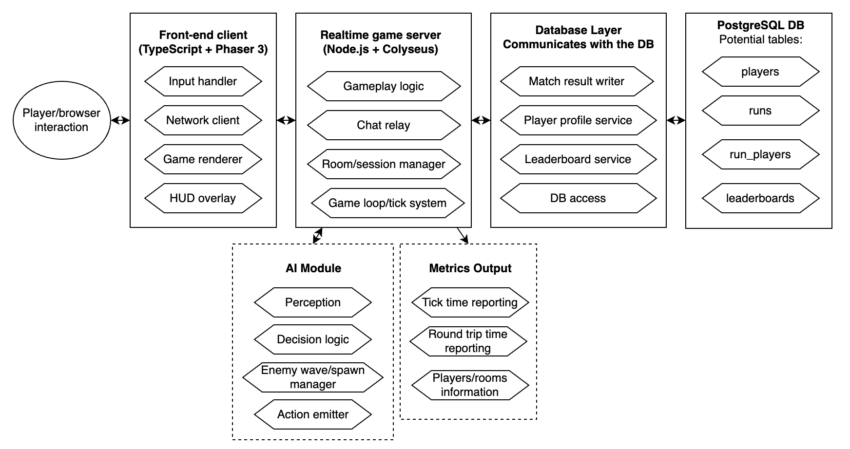
College of engineering and applied science
Design Diagram

Slide 6
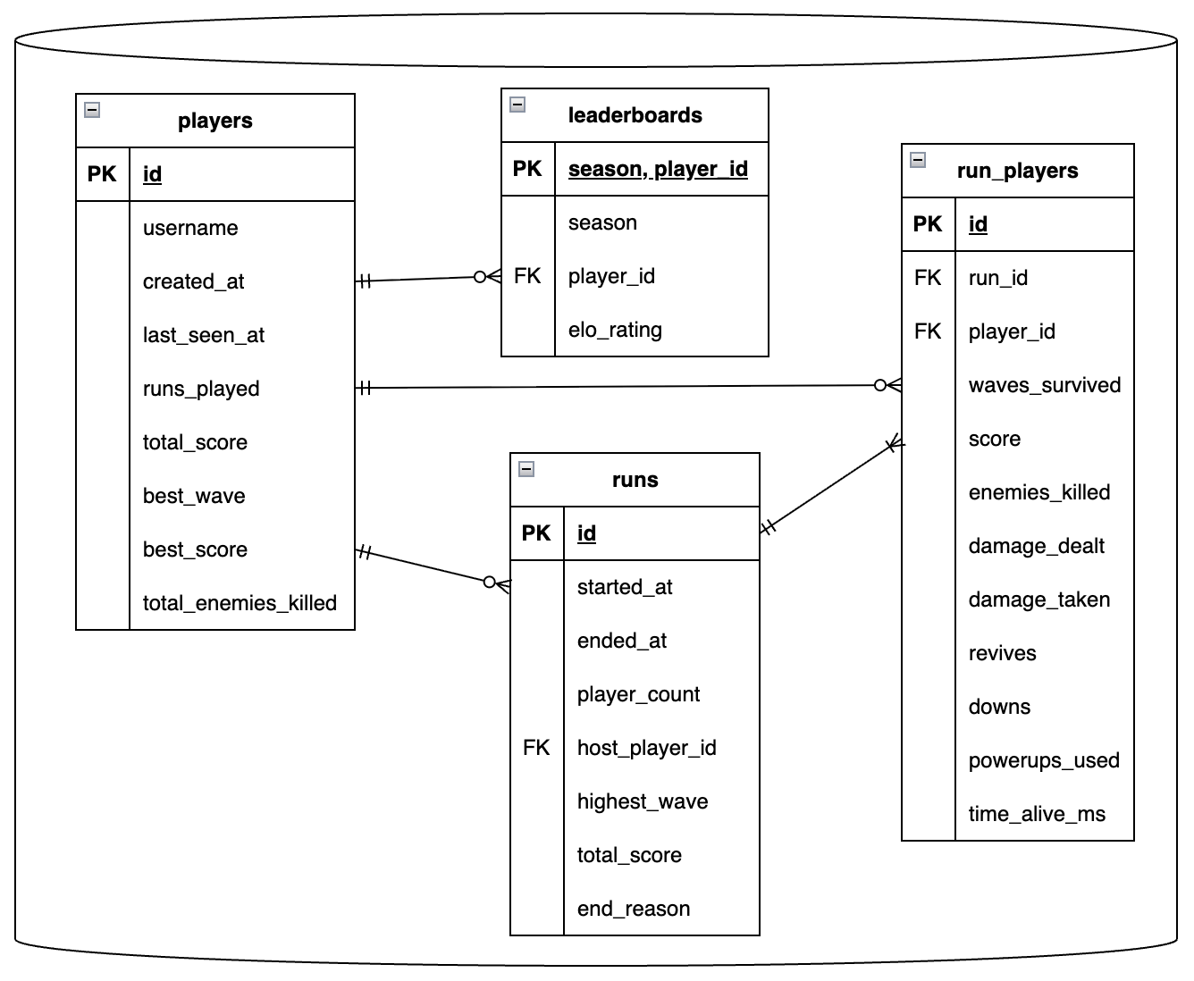
College of engineering and applied science
Database Schema

Slide 7
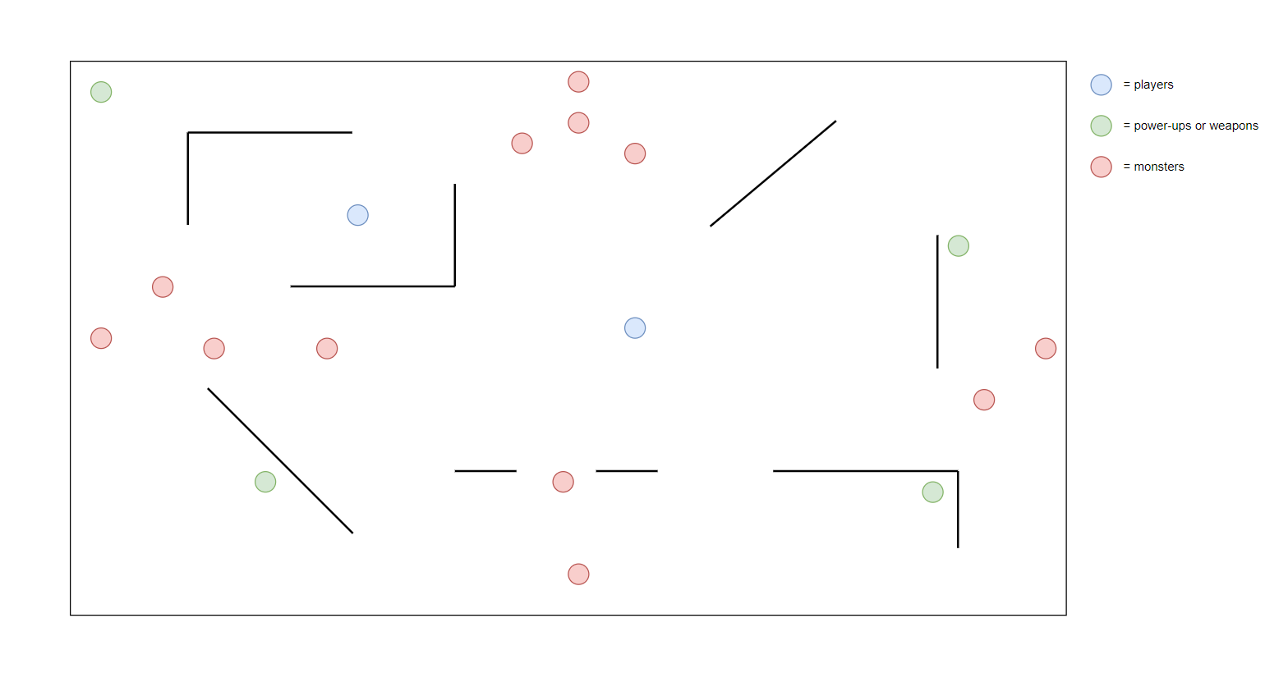
College of engineering and applied science
Game Design

Slide 8
College of engineering and applied science
Game Design
Infinite number of rounds
Goal is to survive as many rounds as possible
Number of enemies begins at 4 for round 1, then increases by 2 each round
Maximum number of enemies will be 30 at round 13
Enemies will still increase in difficulty (faster, stronger, etc.)
3 weapon types: sword, bow, staff
Power-up types: maximum health, speed, and damage increases
Power-ups spawn randomly at dedicated locations on the map

Slide 9
College of engineering and applied science
User Stories
As a player, I want to join an online match so that I can team up with other players in real time
As a player, I want to fight against intelligent AI enemies so that the game is more challenging
As a player, I want to pick up different weapons and power-ups in the arena so that I can gain a strategic advantage and vary my fighting strategy
As a player, I want to view my stats and rankings so that I can track my progress and compare my performance with others
As a player, I want to chat with my opponent during a match so that I can communicate or socialize while playing

Slide 10
College of engineering and applied science
Major Project Constraints
Economic: Must rely entirely on open-source tools and self-hosted testing due to no external budget
Professional: Requires polished, maintainable design suitable for public presentation
Ethical: Avoids collecting personal data and ensures respectful, non-offensive content
Security: Multiplayer networking must prevent cheating and protect player data

Slide 11
College of engineering and applied science
Project Progress
Repository initialized and organized on GitHub
README.md and project documentation completed
Design diagrams (D0-D2) finalized
Initial TypeScript frontend and Node.js backend structure created
Local PostgreSQL database configured and accessible
Development environment builds successfully

Slide 12
College of engineering and applied science
Expected Accomplishments for End of Term
Find and select free sprite art, or create my own
Implement a basic “Hello World” Phaser scene and run it successfully through Vite dev server
Initialize a minimal Colyseus server that starts and responds to basic client connections
Finalize the database schema for player statistics and match history.
Finalize the design of game rules and mechanics

Slide 13
College of engineering and applied science
Expected demo at expo
Two laptops will connect to the same online Pixel Coliseum server over a local or hosted network
Players will enter the same arena and fight off waves of AI-controlled monsters cooperatively until they lose
Real-time multiplayer synchronization, showing smooth movement and shared game state
Players can collect various power-ups and weapons to use strategically
Players can track their scores and view their all-time statistics
The game will also demonstrate the enemy AI system
A small HUD will display health, score, and chat messages for both players
The server’s performance metrics will be visible for debugging or demonstration purposes

Slide 14
THANK YOU

